Slide 1
Mobile Applications Testing
By Nick Thomas

Slide 2

I find your lack of Testing disturbing

Slide 3
Different types of testing
Black box
White box
Unit testing
Integration testing
System testing
Acceptance testing
Regression testing

Slide 4
Black Box
Input
Output
Black Box

Slide 5
Black Box Cont
This method attempts to find errors in the following categories:
Incorrect or missing functions
Interface errors
Errors in data structures or external database access
Behaviour or performance errors
Initialization and termination errors
Test Name | Test Input | Expected outcome | Actual outcome | result
Test Add function | 1 2 | 3 | 99 | FAIL
Notes:
Black-box testing is a method of software testing that examines the functionality of an application based on the specifications.
also known as Specifications based testing.
Independent Testing Team usually performs this type of testing during the software testing life cycle.

Slide 6
White Box
Examines the program structure and derives test data from the program logic/code.
Statement Coverage - This technique is aimed at exercising all programming statements with minimal tests.
Branch Coverage - This technique is running a series of tests to ensure that all branches are tested at least once.
Path Coverage - This technique corresponds to testing all possible paths which means that each statement and branch is covered.

Slide 7
Advantages of White Box Testing
Forces test developer to reason carefully about implementation.
Reveals errors in "hidden" code.
Spots the Dead Code or other issues with respect to best programming practices.

Slide 8
Disadvantages of White Box Testing
Expensive as one has to spend both time and money to perform white box testing.
Every possibility that few lines of code are missed accidentally.
In-depth knowledge about the programming language is necessary to perform white box testing.

Slide 9
Unit testing
Testing certain functions, areas or units of our code.
Helps us to identify failures in our algorithms and/or logic
End up creating a suite of tests that you can run at any time during development to continually verify the quality of your code
you'll end up writing code that is easy to test
higher number of smaller, more focused functions that provide a single operation on a set of data rather than large functions performing a number of different operations.
you can prevent future changes from breaking functionality.

Slide 10
Unit Testing Cont
This comes at the expense of investing time to write a suite of tests early in development

Slide 11
Unit Testing example (Nunit)
[TestFixture]
public class TestClass
{
[TestCase]
public void AddTest()
{
MathsHelper helper = new MathsHelper();
int result = helper.Add(20, 10);
Assert.AreEqual(30, result);
}
[TestCase]
public void SubtractTest()
{
MathsHelper helper = new MathsHelper();
int result = helper.Subtract(20, 10);
Assert.AreEqual(10, result);
}
}
public class MathsHelper
{
public int Add(int a, int b)
{
int x = a + b; return x;
}
public int Subtract(int a, int b)
{
int x = a - b; return x;
}
}

Slide 12
Integration testing
Testing methodology used to test individual software components or units of code to verify interaction between various software components and detect interface defects.
small software systems are integrated and tested in a single phase
integrating modules into low-level subsystems for integration with larger subsystems.

Slide 13
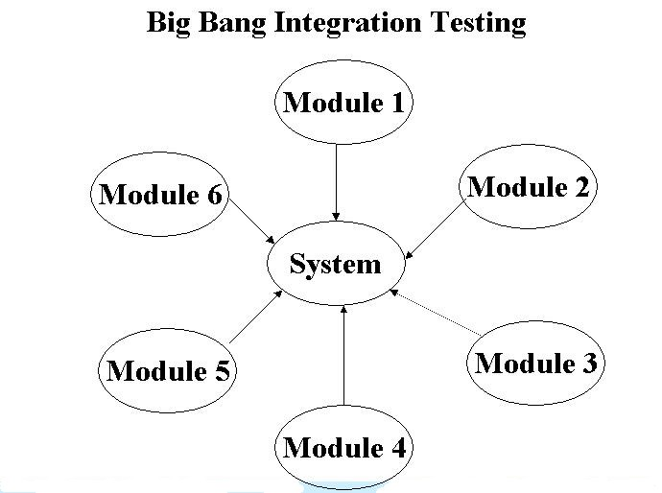
Integration testing Big Bang
Big Bang: Involves integrating modules to build a complete system.
Considered a high-risk approach because it requires proper documentation to prevent failure.

Slide 14
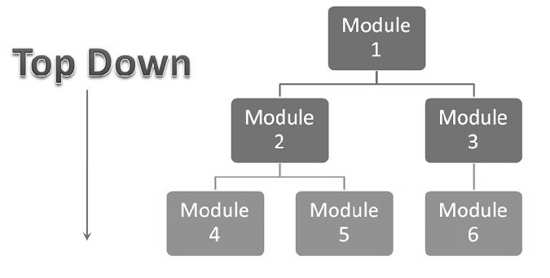
Integration testing Top Down
Top-Down: Involves testing the top integrated modules first. Subsystems are tested individually.
Top-down testing facilitates detection of lost module branch links.
Modules stubs temporary replace the actual called module and give the same output as that of the actual product. Simulates behaviour of lower level modules before they are tested.

Slide 15
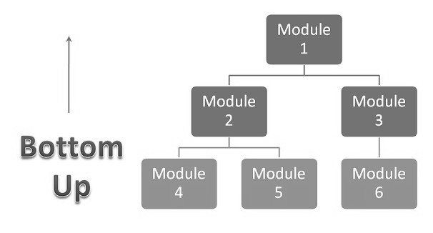
Integration testing Bottom up
Bottom-Up: Involves low-level component testing, followed by high-level components.
Testing continues until all hierarchical components are tested.
Bottom-up testing facilitates efficient error detection.

Slide 16
Integration testing Cont
After the integration testing has been performed on the components, they are readily available for system testing.

Slide 17
System testing
Black Box testing technique
check the behaviour of a complete and fully integrated software
based on the software requirements specification (SRS) document.
The main focus of this testing is to evaluate Business / Functional / End-user requirements.

Slide 18
System testing Cont
This is black box type of testing
where external working of the software is evaluated with the help of requirement documents
it is totally based on Users point of view
This type of testing does not require knowledge of internal design or structure or code

Slide 19
System testing Why its important
First level of testing where the System is tested as a whole.
Check if system meets functional requirement or not.
System Testing enables you to test, validate and verify both the Application Architecture and Business requirements.
The application/System is tested in an environment that particularly resembles the effective production environment (where the application will be deployed).

Slide 20
Acceptance testing
testing technique performed to determine whether or not the software system has met the requirement specifications.
evaluate the system's compliance with the business & end user requirements

Slide 21
Acceptance testing Cont
Business Acceptance Testing (BAT) is undertaken within the development organization of the supplier to ensure the system will eventually pass user acceptance testing.
User Acceptance Testing (UAL) is conducted by the customer to ensure the system satisfies is contractual acceptance criteria before being signed-off as meeting user needs.

Slide 22
Acceptance testing Alpha
Alpha testing takes place at the developer's site by the internal teams, before release to external customers.
This testing is performed without the involvement of the development teams. (Generally)

Slide 23
Acceptance testing Beta
Beta testing also known as user testing takes place at the end users site by the end users to validate the usability, functionality, compatibility, and reliability testing.
Beta testing allows the "real" customer an opportunity to provide inputs into the design, functionality, and usability of a product.

Slide 24
Regression testing
black box testing technique
consists of re-executing those tests that are impacted by the code changes.
Regression testing is performed to verify the build has NOT broken any other parts of the application by any recent code changes.

